Slide 1
HR ANALYTICS
Group No - 1

Slide 2
Team Members
4. Narmadha
Radhakrishnan
3. Manoj Kumar Reddy
2. Asha A
6. Vaishali Badgujar
1. Anjali Thombre
5. Samrat Jha

Slide 3
INDEX
KPI-1 Average Attrition Rate For All Departments
KPI-2 Average Hourly Rate For Male Research Scientist
KPI-3 Attrition Rate Vs Monthly Income Status
KPI-4 Average Working Years For Each Department
KPI-5 Job Role Vs Work Life Balance
KPI-6 Attrition Rate Vs Year since last Promotion Relation
KPI-7 Total Attrition by Employee Education
KPI-8 Marital Status and Monthly Income Vs Attrition Rate
Dashboard Insights :-
Excel
Power BI
Tableau
SQL Queries
Internship Challenges & Solutions
Conclusion

Slide 4
KPI-1 Average Attrition Rate For All Departments
Observations :-
Overall attrition is around 50% across departments.
R&D has the highest attrition 51.21%
Hardware has the lowest 49.44%.
Variation between departments is minimal.
Findings :-
Attrition appears to be an organization-wide issue rather than department-specific.
Slightly higher turnover in R&D may impact innovation and performance.
Narmadha
Radhakrishnan

Slide 5
KPI-2 Average Hourly Rate For Male Research Scientist
Observations:-
The average hourly rate is 114.45
Male Research Scientists are part of the R&D department.
R&D shows relatively higher attrition 51.21%.
Findings:-
Compensation is competitive and well-structured.
However, higher attrition suggests salary alone does not ensure retention.

Slide 6
KPI–3 Attrition Rate Vs Monthly Income Status
Observations :- • Attrition around 50% across income groups • Highest in 50001–60000 (51.26%) • Lowest in 30001–40000 (49.80%) • Variation between income groups is minimal • Salary difference does not strongly change attrition
Findings :-
• Attrition is not salary-dependent • High-income employees also leaving • Other factors influencing turnover

Slide 7
KPI-4 Average Working Years For Each Department
Observations :-
• Average working years ≈ 20.5 years • Software has highest average tenure (20.65) • R&D has lowest average tenure (20.30) • Very small variation across departments • Workforce experience is stable
Findings :-
• Employees are highly experienced across departments • No major tenure gap between departments • Slightly lower tenure in R&D may link to higher attrition

Slide 8
KPI-5 Job Role Vs Work Life Balance
Observations :-
• Average score ≈ 2.50 • Research Scientist / Developer / Healthcare Rep – 2.51 (Highest) • Research Director / Laboratory Technician – 2.49 (Lowest) • Very small variation (~0.02)
Findings :-
• Work-life balance similar across roles • No major role-specific imbalance • Slightly lower balance in Sales roles • Overall moderate satisfaction level

Slide 9
KPI-6 Attrition Rate Vs Year Since last Promotion relation
Observations :-
• 1–10 years since last promotion → 50.24% • 11–20 years → 49.84% (Lowest attrition) • 21–30 years → 50.96% (Highest attrition) • 31–40 years → 50.90%
• Overall variation is very small (~1% range)
Findings :-
• Attrition slightly increases when employees wait longer (21+ years) for promotion • Employees in 11–20 years range show relatively lower attrition • However, overall impact is moderate since variation is minimal • Promotion policy improvement could help reduce attrition in long-tenure employees

Slide 10
KPI-7 Total Attrition by Employee Education
Observations :-
• Medical → 50.81% (Highest) • Other → 50.62% • Human Resources → 50.28% • Marketing → 50.07%
• Technical Degree → 50.06%
• Life Sciences → 49.41% (Lowest)
• Overall variation is very minimal (~1.4% range)
Findings :-
• Attrition rate is almost consistent across all education backgrounds. • Medical and “Other” education categories show slightly higher attrition • Life Sciences employees show comparatively better retention • Education qualification alone does not strongly impact attrition.
• Other factors like role, promotion gap, workload, or salary may have stronger influence

Slide 11
KPI-8 Marital Status and Monthly Income Vs Attrition Rate
Observations :-
• Income slabs across all marital statuses show attrition around 49% – 52% range • Divorced employees show slightly higher attrition at higher income slabs (peaking around 52.8%) • Married employees show relatively stable attrition (~50–51%) • Single employees show moderate variation (~48.8% – 50.5%) • Technical Degree → 50.06%
• No drastic difference observed across income categories •
• Overall variation is minimal (~3–4% range)
Findings :-
• Monthly income does not show a strong impact on attrition. • Marital status has slight influence, especially in higher income groups • Divorced employees appear slightly more prone to attrition at higher salary levels • Education qualification alone does not strongly impact attrition.
• Overall, attrition seems influenced more by organizational factors rather than income or marital
status alone

Slide 12
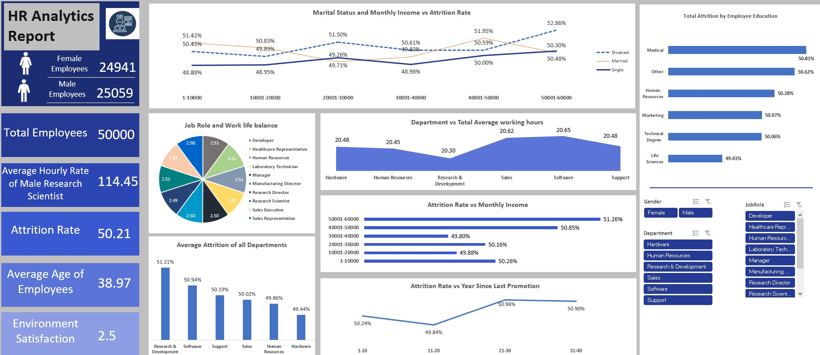
Excel Dashboard Screenshot

Slide 13
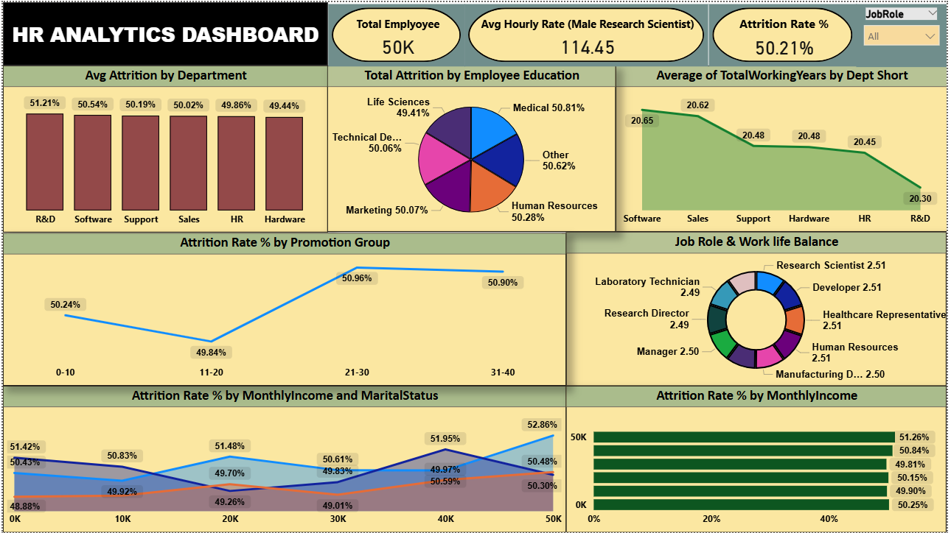
Power BI Dashboard Screenshot

Slide 14
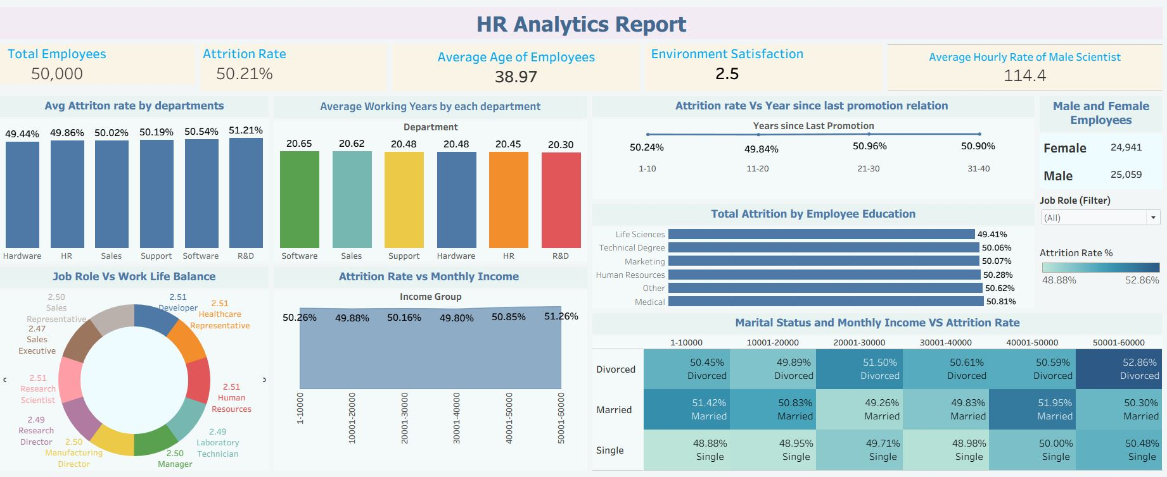
Tableau Dashboard Screenshot

Slide 15
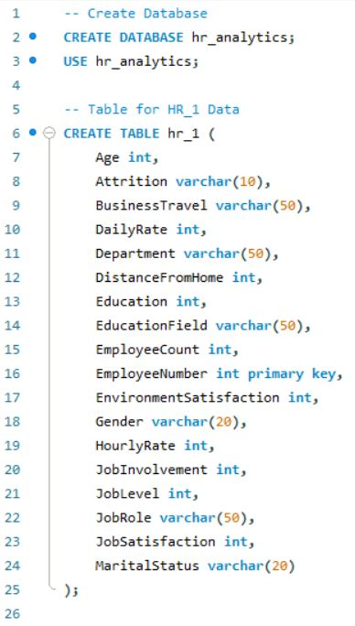
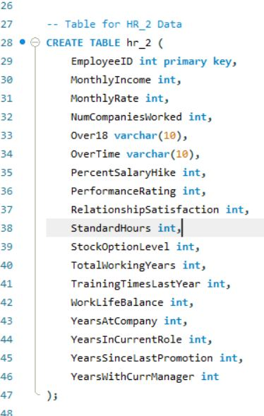
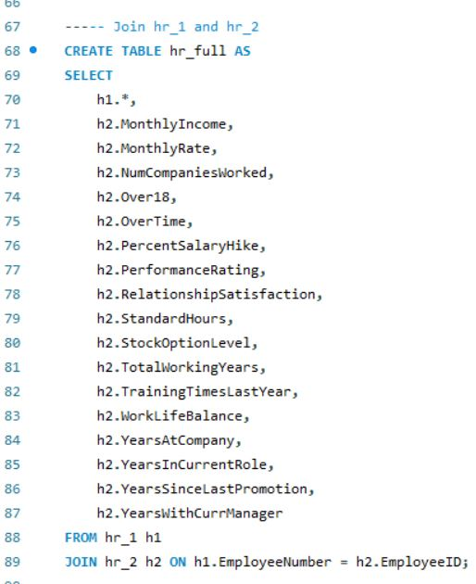
My SQL Queries

Slide 16
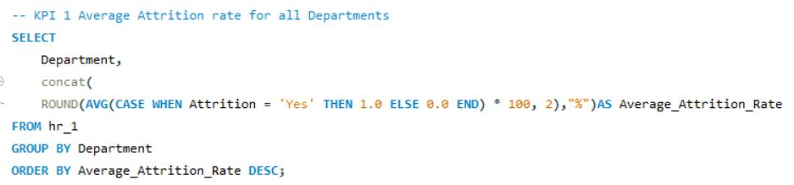
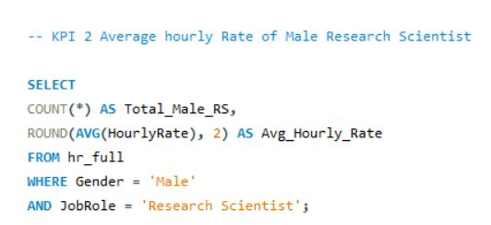
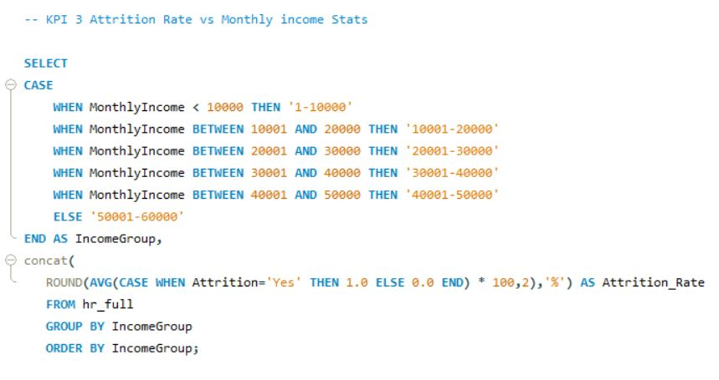
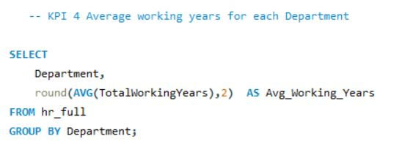
My SQL Queries KPI’s

Slide 17
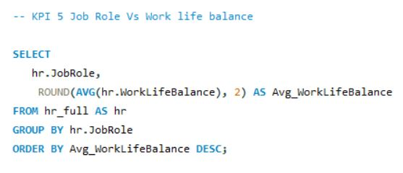
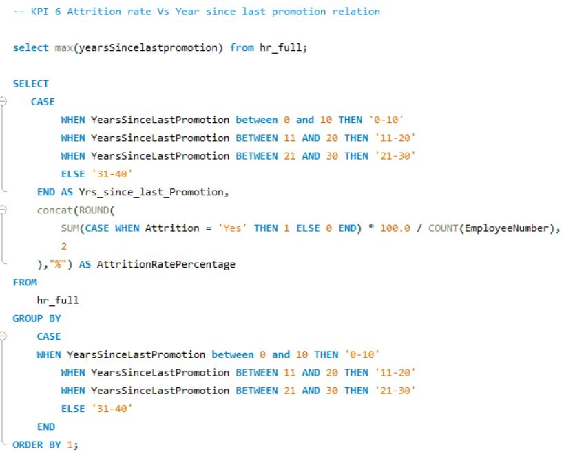
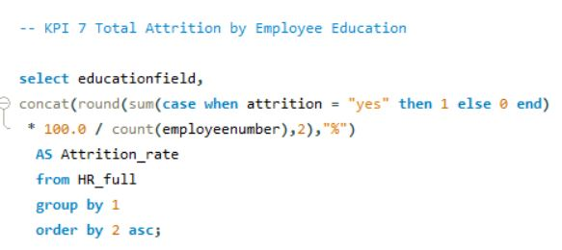
My SQL Quires KPI’s

Slide 18
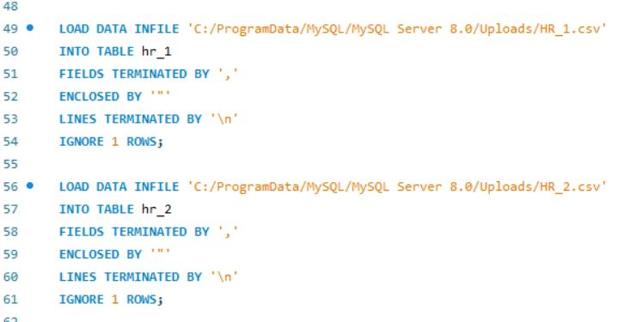
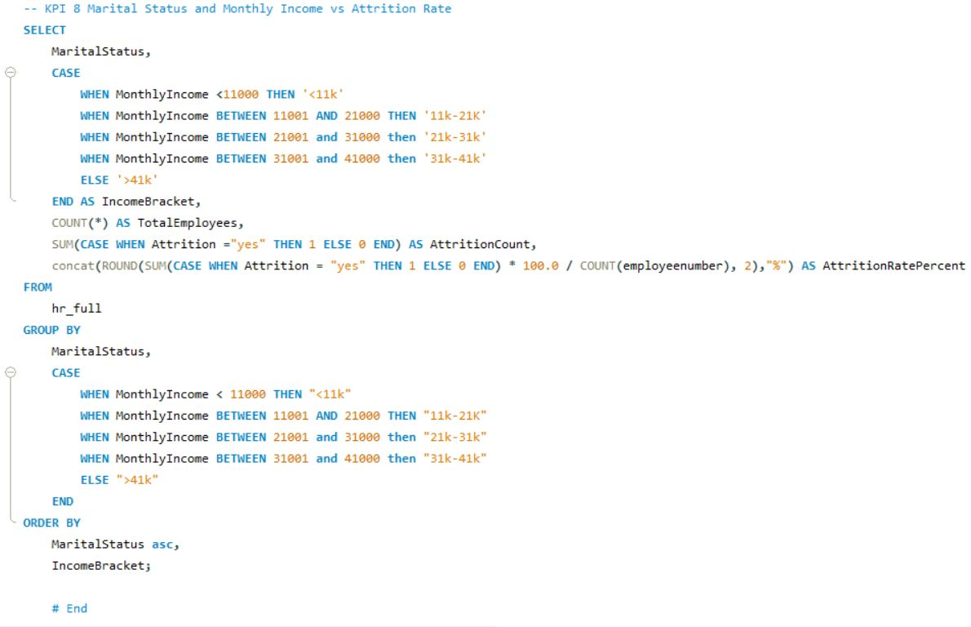
My SQL Quires KPI’s

Slide 19
Challenges faced and how we overcame them
Challenge 1: Integrating Disparate Data Sources
Challenge 2: Identifying Trends in Uniform Data
Challenge 3: Visualizing Continuous Variables

Slide 20
Conclusion
Revamp Promotion Cycles
Focus on Culture Over Compensation
Elevate Work-Life Balance
Target R&D Retention

Slide 21

THANK YOU

